Slide 1
Polymer SCFT for Studying Ionomer Morphology in PEMFCs
07/22/2024
Takashi Yokokura, Wang Group

Slide 2
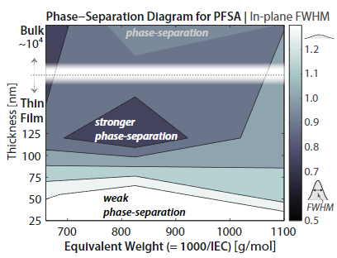
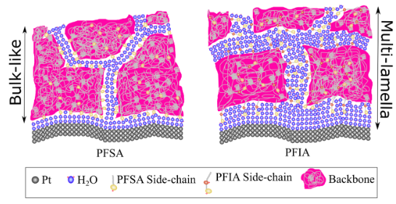
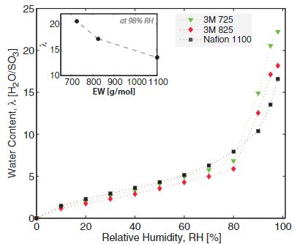
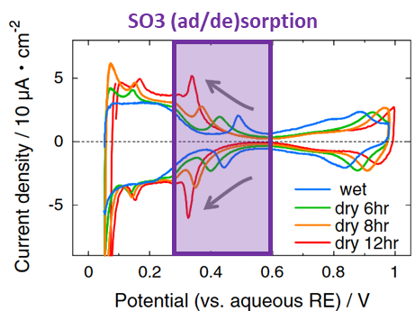
Ionomer morphology underlies key questions in PEMFCs
Sidechain effects
Confinement effects
How do we optimize PEMFC structure?
Hydration / Humidity
Pt poisoning mechanism
How do we optimize PEMFC operation?
Shirvastava et al. Macromolecules 2018, 51, 9839−9849; Kusoglu et al. Adv. Funct. Mater. 2016, 26, 4961–4975; K. Kodama et al. Electrochemistry Communications 36 (2013) 26–28

Slide 3
Ionomer morphology underlies key questions in PEMFCs
Sidechain effects
Confinement effects
How do we optimize PEMFC structure?
We seek to provide molecular details underlying complex polymer morphologies by developing and applying robust theories.
Hydration / Humidity
Pt poisoning mechanism
How do we optimize PEMFC operation?
Shirvastava et al. Macromolecules 2018, 51, 9839−9849; Kusoglu et al. Adv. Funct. Mater. 2016, 26, 4961–4975; K. Kodama et al. Electrochemistry Communications 36 (2013) 26–28

Slide 4
Outline
Overview of polyelectrolytes
What are the key interactions that need to be accounted for?
Why is the interplay between these interactions important?
What kind of insight can theory provide for polyelectrolyte systems?
Brief derivation of our self-consistent field theory
What are the key equations for studying the morphologies of PEMs?
Proposal for application to Ionomer—Pt interface
What can our theory provide on the mechanism of Pt poisoning?

Slide 5
Outline
Overview of polyelectrolytes
What are the key interactions that need to be accounted for?
Why is the interplay between these interactions important?
What kind of insight can theory provide for polyelectrolyte systems?
Brief derivation of our self-consistent field theory
What are the key equations for studying the morphologies of PEMs?
Proposal for application to Ionomer—Pt interface
What can our theory provide on the mechanism of Pt poisoning?

Slide 6


Polyelectrolyte behavior is controlled by three main interactions
Elasticity – polymer chains are formed by a series of connected monomers
Hydrophobicity (attraction) – van der Waals interactions between monomers and solvent
Electrostatics (repulsion) – charged monomeric groups and dissolved salt ions
Monomer
Solvent
$$+$$
$$−$$
The relative strengths of these interactions are determined by monomer chemistry (e.g., backbone, sidechain EW, etc.) and environment (e.g., temperature, humidity)

Slide 7
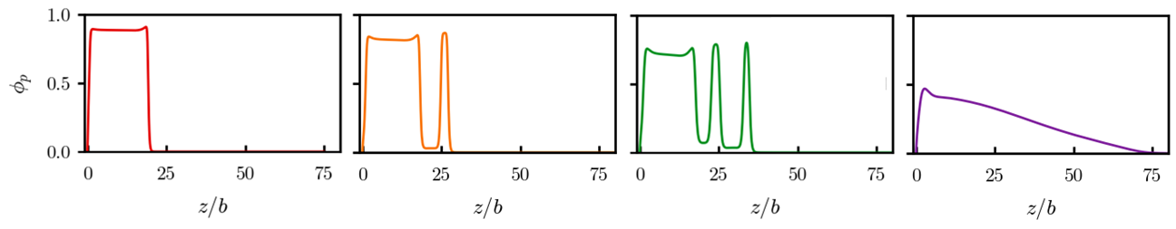
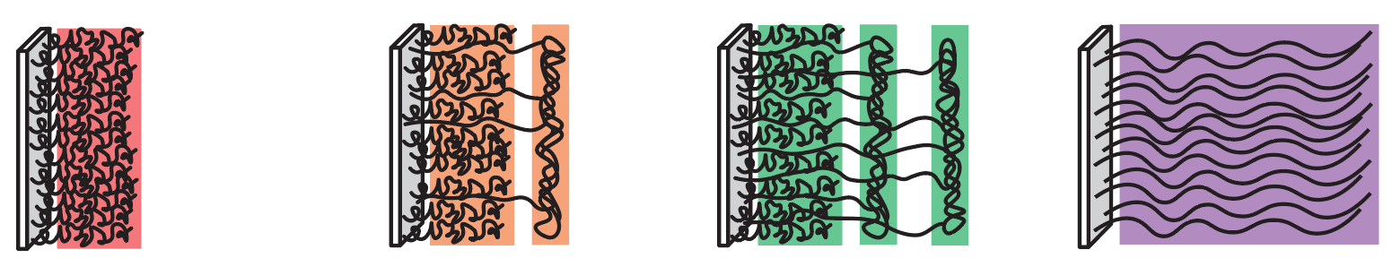
These interactions dictate polyelectrolyte morphology
Competition between hydrophobicity, long-range electrostatics, and polymer elasticity can lead to complex morphologies
Example: moderately charged brushes for decreasing hydrophobicities $χ$
Polymer density distributions from SCFT
Corresponding schematic (insight)
Fully condensed
(Attraction-dominated)
Microphase segregated
Fully swollen (Repulsion-dominated)
Yokokura, Duan, Wang. 2024. In preparation, will be put on Arxiv very soon

Slide 8
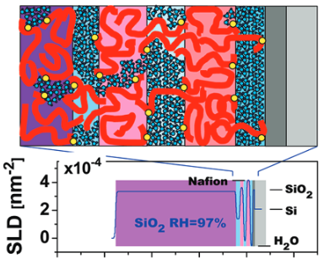
These interactions dictate polyelectrolyte morphology
Competition between hydrophobicity, long-range electrostatics, and polymer elasticity can lead to complex morphologies
Example: moderately charged brushes for decreasing hydrophobicities $χ$
Polymer density distributions from SCFT
Corresponding schematic (insight)
Fully condensed
(Attraction-dominated)
Microphase segregated
Fully swollen (Repulsion-dominated)
Dura et al. Macromolecules, Vol. 42, No. 13, 2009

Slide 9
Outline
Overview of polyelectrolytes
What are the key interactions that need to be accounted for?
Why is the interplay between these interactions important?
What kind of insight can theory provide for polyelectrolyte systems?
Brief derivation of our self-consistent field theory
What are the key equations for studying the morphologies of PEMs?
Proposal for application to Ionomer—Pt interface
What can our theory provide on the mechanism of Pt poisoning?

Slide 10
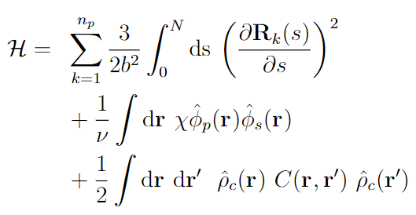





Our SCFT systematically includes these coupled interactions
Elasticity (Gaussian chain)
Hydrophobicity (Flory—Huggins)
Long-range electrostatics
Polymer path
Local polymer volume fraction
Local solvent volume fraction
Local charge density
Coulomb operator (PB equation)

Slide 11
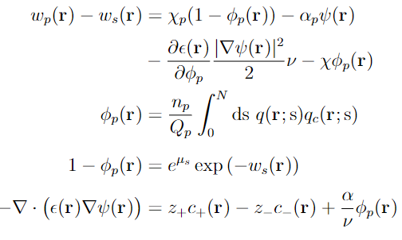

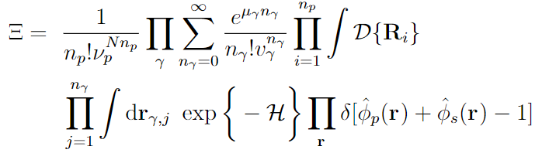

Self-consistent field equations provide microscopic details
Interactions
Self-consistent Field Equations
Particle-to-field and Hubbard—Stratonovich transforms, saddle-point approximation, functional minimization
System
For PEMs, we are most interested in polymer, sidechain, and proton distributions
(e.g., const. number of polymers, system connected to bulk solvent and salt solution)

Slide 12
Outline
Overview of polyelectrolytes
What are the key interactions that need to be accounted for?
Why is the interplay between these interactions important?
What kind of insight can theory provide for polyelectrolyte systems?
Brief derivation of our self-consistent field theory
What are the key equations for studying the morphologies of PEMs?
Proposal for application to Ionomer—Pt interface
What can our theory provide on the mechanism of Pt poisoning?

Slide 13
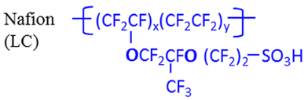
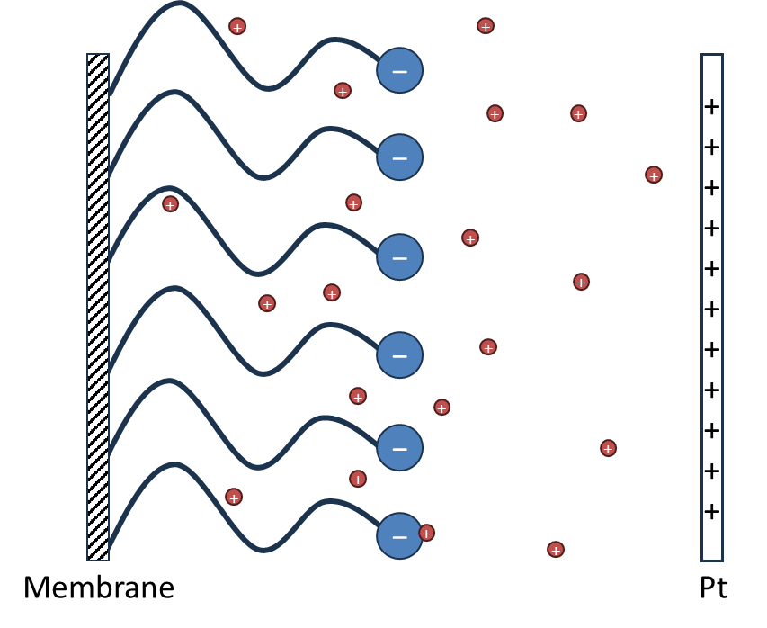
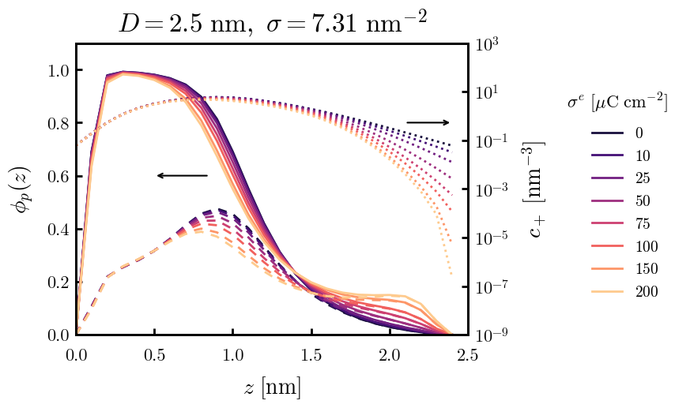
Rudimentary proof-of-concept: considering sidechains only
Model: “grafting substrate” is the “bulk” thin film. Sidechains are uniformly tethered to the surface.
Polymer density distributions illustrates the effect of Pt surface charge density on thin-film morphology
As charge increases, the degree of polymer poisoning increases
The vast majority of the density near Pt is composed of SO3− (dashed)
Proton distributions (dotted) illustrate the competing effects between increased (+) surface charge density and the ion cloud surrounding the SO3− groups
However, this model does not account for the rest of the film (e.g., elasticity of the ionomer backbones)

Slide 14
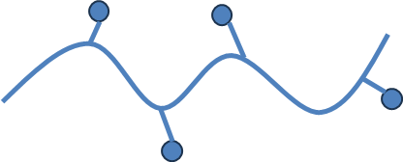
Proposed system for Ionomer—Pt interface at varying humidities
Pt
Effects on ionomer morphology by
Pt potential
Ionomer chemistry
Equivalent weight, sidechain length, etc.
Water uptake (e.g., number of water molecules)
Our SCFT would provide
Polymer/Sidechain density distributions
Proton distributions
Mechanisms underlying morphological changes
Entire ionomer chains (backbone + sidearms)
Ions
Water (liquid)

Slide 15
Previous Work

Slide 16
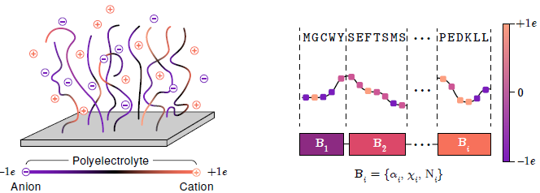
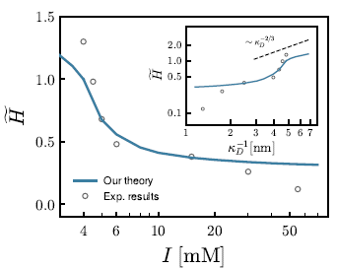
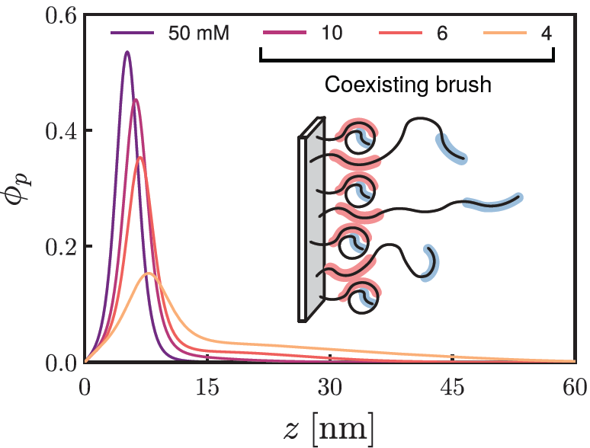
Stimuli-sensitive, protein-derived brushes (1)
Yokokura, Duan, Ding, Kumar, Wang. Biomacromolecules 2024, 25, 328−337

Slide 17
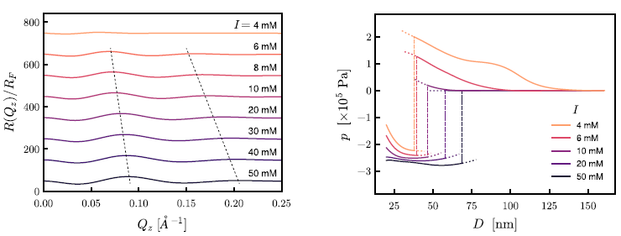
Stimuli-sensitive, protein-derived brushes (2)
Yokokura, Duan, Ding, Kumar, Wang. Biomacromolecules 2024, 25, 328−337

Slide 18
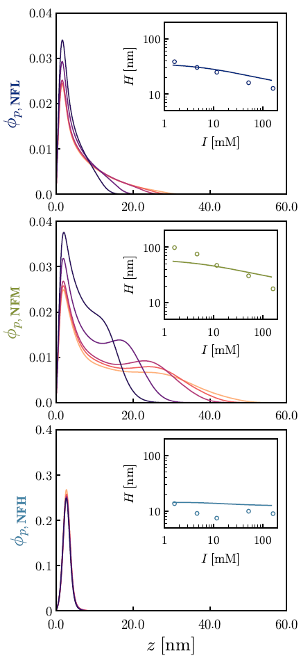
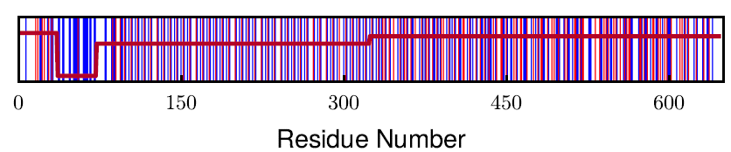
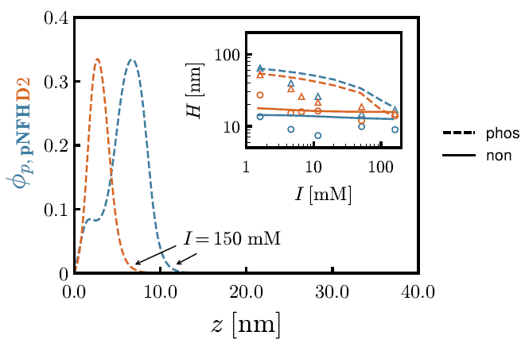
Sequence—Structure Relationship in Neurofilaments (1)
Ding, Yokokura, Wang, Kumar. PNAS. Under review

Slide 19
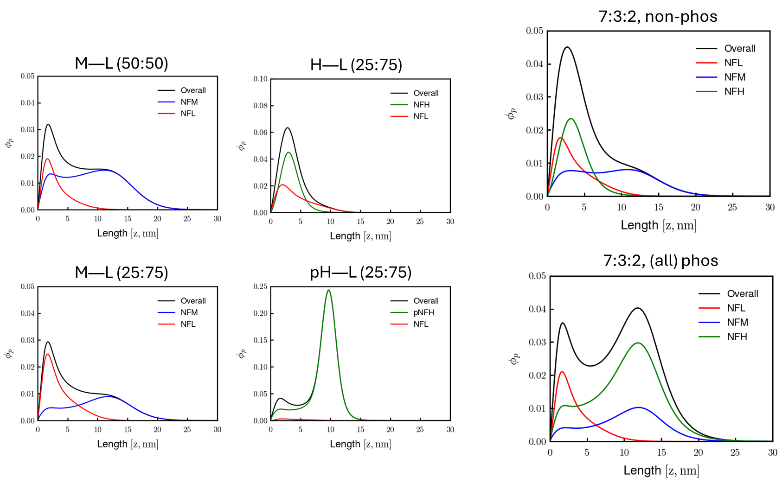
Sequence—Structure Relationship in Neurofilaments (2)
Ding, Yokokura, Wang, Kumar. PNAS. Under review

Slide 20
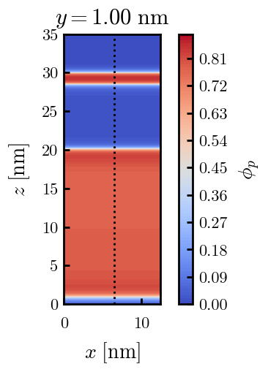
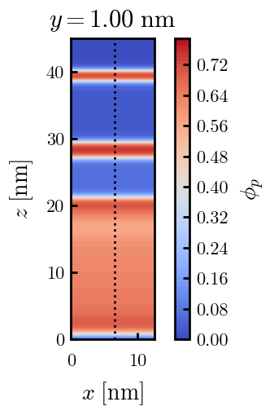
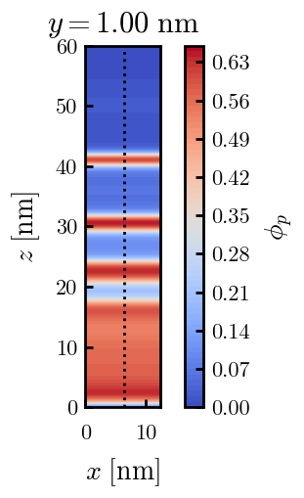
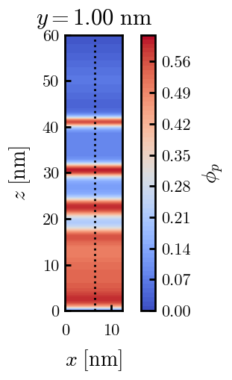
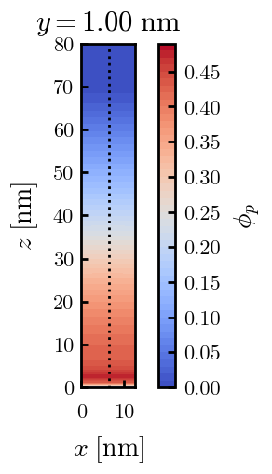
3D PE Brushes (preliminary)
Yokokura, Duan, Wang. In progress

Slide 21
